Slide 1
OPENSHIFT ARCHITECTURE

Slide 2
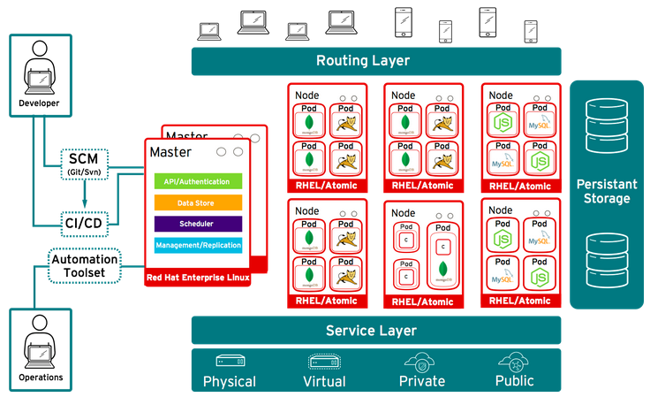
OPENSHIFT WORK FLOW

Slide 3
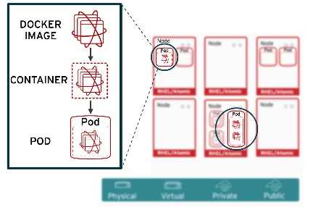
PODS ARCHITECTURE

Slide 4
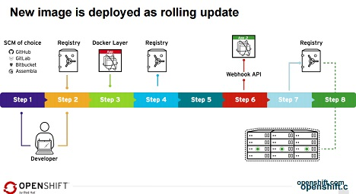
WORKFLOW OF IMAGE BUILD

Slide 5
OPENSHIFT COMPONENTS
Master node →
Api contorller, scheduler,webconsole
Etcd → Responsible for holding state data for the cluster)Master api →handling requests from clients, including Nodes, Users, Administrators, and other Infrastructure systems Scheduler and Replication Controller OpenShift Client tools (oc and oadm).
Nodes Components
Docker
OpenVSwitch (OVS)
OpenShift Node → All hosts in the cluster should have the atomic-openshift-node service active and enabled.
Kubelet service
Kube proxy service → manage pods,volumes,secrets,creating,new containers, Docker

Slide 6
Master
Etcd Datastore → (Responsible for holding state data for the cluster) and its store the data as token in a database.
Master API→ (Responsible for handling requests from clients, including Nodes, Users, Administrators, and other Infrastructure systems deployed to OpenShift).
Master Controllers →(Includes the Scheduler and Replication Controller).
OpenShift Client tools (oc and oadm).

Slide 7
OpenVSwitch (OVS)
OpenVSwitch is required on every host in order to support the OpenShift SDN communication.
OpenShift Container Platform uses a software-defined networking (SDN) approach to provide a unified cluster network that enables communication between pods across the OpenShift Container Platform cluster. This pod network is established and maintained by the OpenShift SDN, which configures an overlay network using Open vSwitch (OVS).
OpenShift SDN provides three SDN plug-ins for configuring the pod network:
The ovs-subnet plug-in is the original plug-in, which provides a "flat" pod network where every pod can communicate with every other pod and service.
The ovs-multitenant plug-in provides project-level isolation for pods and services. Each project receives a unique Virtual Network ID (VNID) that identifies traffic from pods assigned to the project. Pods from different projects cannot send packets to or receive packets from pods and services of a different project.

Slide 8
Source-to-Image
(S2I) is a framework that makes it easy to write images that take application source code as an input and produce a new image that runs the assembled application as output.
Pod
A Kubernetes pod is a group of containers that are deployed together on the same host.
Pods operate at one level higher than individual containers because it's very common to have a group of containers work together to produce an artifact or process a set of work.
Resources
Resource limits such as CPU and RAM are shared between all containers in the pod.
Infra Node
Infra node is routes and expose the address to outside of the world.

Slide 9
Image Registry
OpenShift provides an integrated Docker registry that adds the ability to provision new image repositories.
Whenever a new image is pushed to the integrated registry, the registry notifies OpenShift about the new image, passing along all the information about it, such as the namespace, name, and image metadata.
Kubelet
Its used to run on nodes and it communicate with master . Its the master component for nodes
Kubelet proxy
Its same like OVS. Pods are communicate between using proxy and Dns is maintain by Kublet proxy for nodes.
Service Proxy
Each node also runs a simple network proxy that reflects the services defined in the API on that node. This allows the node to do simple TCP and UDP stream forwarding across a set of back ends.

Slide 10
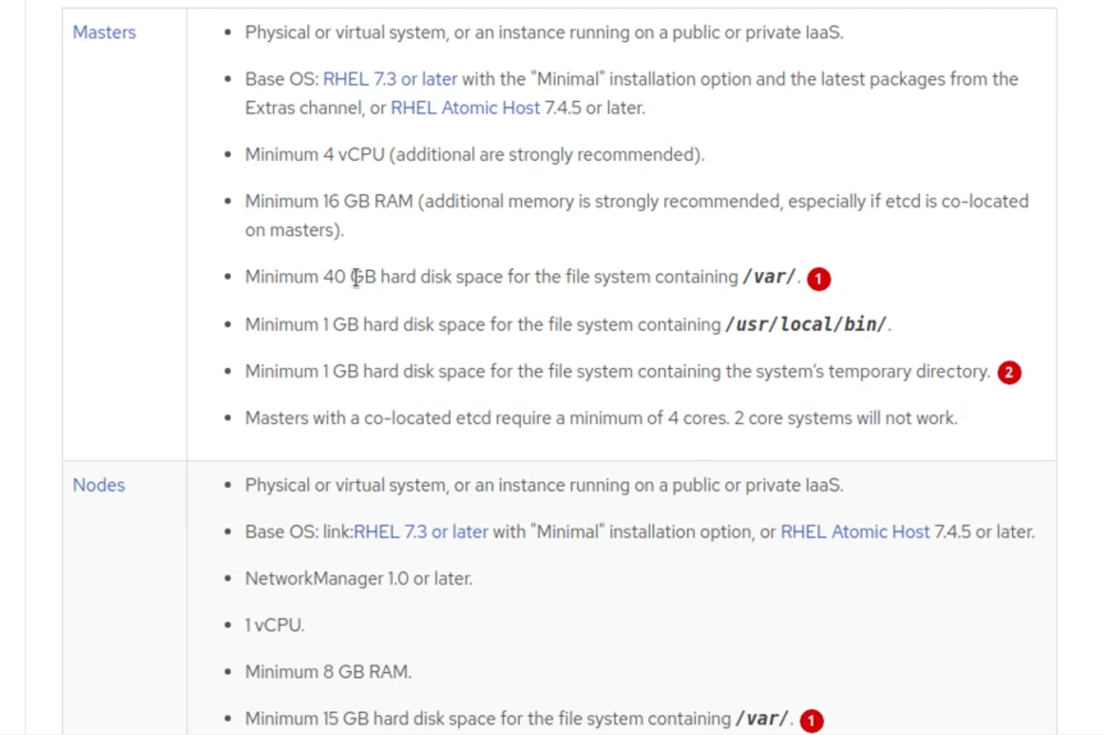
Hardware Requirements

